Slide 1
Using the tardis server

Slide 2
How to connect:
Via the terminal:
ssh yoursalkid@tardis.salk.edu
It’ll ask you to trust the server when accessing for the 1st time.
It’ll always ask for your password.
If you have not changed it yet, the password is: Just4now!123
Change your password please!
After login use the ‘passwd’ command and follow the prompts.

Slide 3
How to connect:
For RStudio only:
Connect via web browser:
http://tardis.salk.edu:8787
Use your salk id as the username. The password will be the same you setup for the server (or Just4now!123 if you have not changed it yet).

Slide 4
Folder structure inside the server
What you care about:
Your home folder (cd ~)
– you can use this to save small scripts and such, to keep your libraries (for R, python, etc), or to install small programs.
Your data folder (cd /data/user_data/yourname)
Larger data storage space for files and analysis reults.
THIS SHOULD BE TEMPORARY. THE SERVER IS NEVER BACKED UP.
Notes: /data/genomes – has the genomes for STAR
/opt/scripts – has the scripts we got from igc2

Slide 5
Adding things to the PATH
Add the path to folder and programs you want to access to your bash_profile:
From home (cd ~)
Use vi .bash_profile to open it
Then press i to edit. Find a part that looks like this:
PATH=$PATH:$HOME/.local/bin:$HOME/bin
You can add new paths by adding a : followed by the new path.
PATH=$PATH:$HOME/.local/bin:$HOME/bin:/bin/STAR/source/:/usr/share
Press Esc, then type :save .bash_profile and Enter.
Type :!q to quit

Slide 6
Where to find NGS script examples
/data/users_data/Scripts_for_all
Right now there is:
one example of RNA-seq analysis;
A how to use the server document;
A git tutorial
- More to come soon.

Slide 7
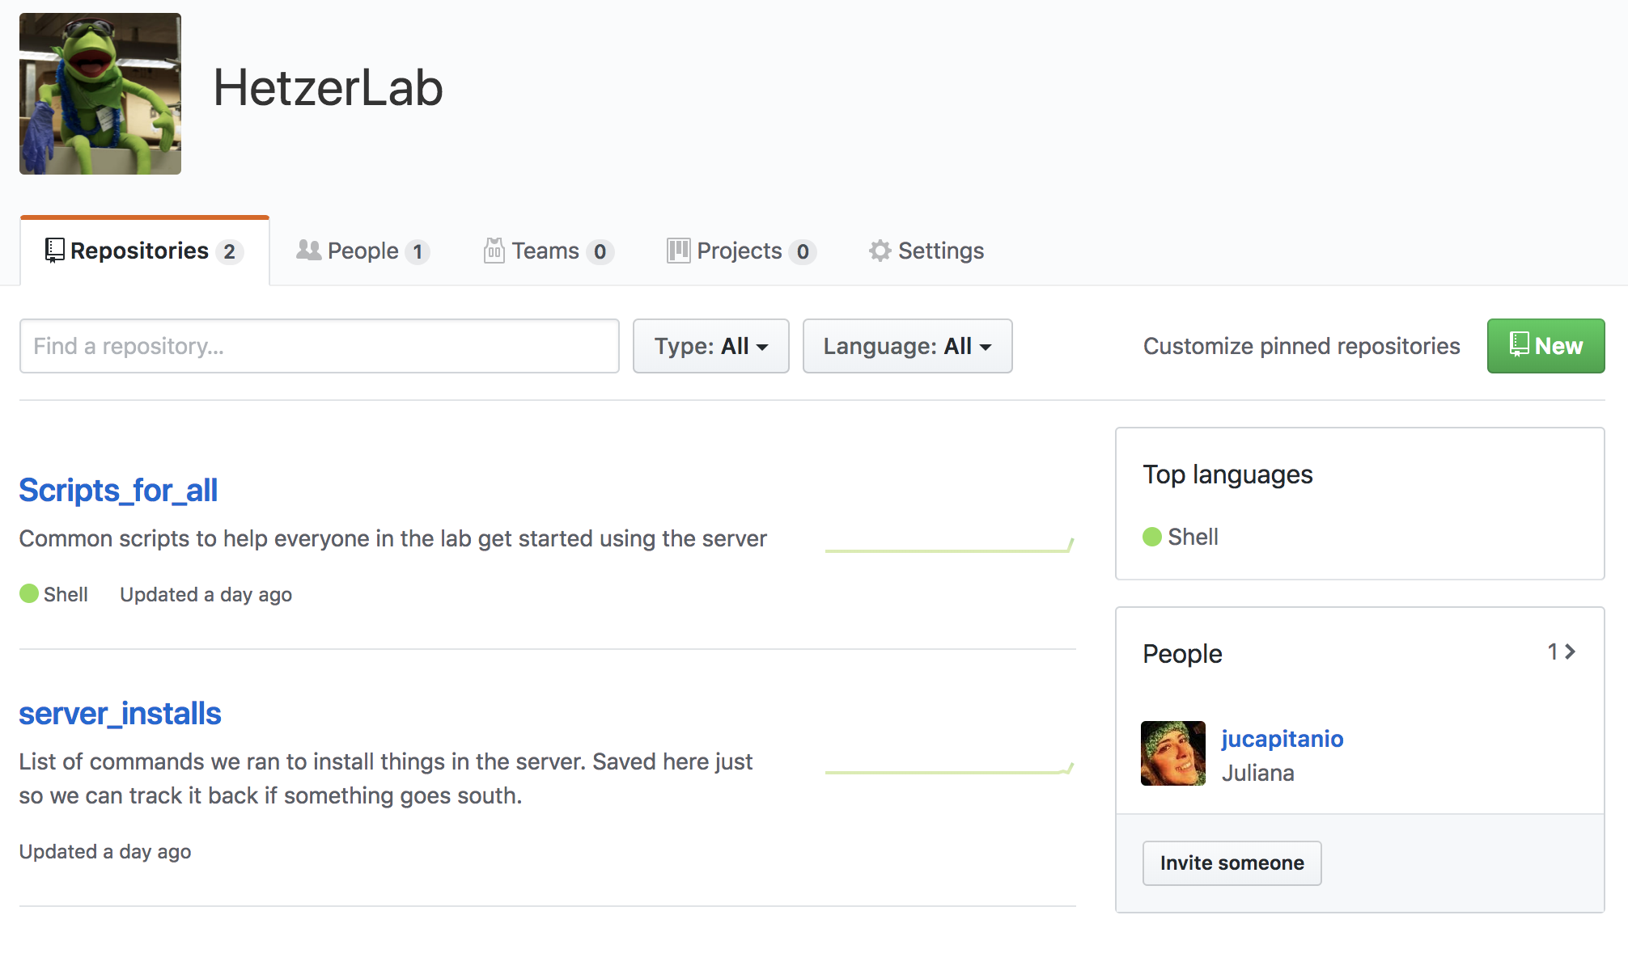
Go to: github.com
Create an account.
Send you username to Juliana or Swati
Search for HetzerLab on github
Click on the users tab
Accept invitation
The latest of all scripts will live here.
This is all open to the public, so careful.

Slide 8
How to use the HetzerLab github repo:
# If you'd like to copy a repository that is on github to your computer:
git clone https://github.com/HetzerLab/Scripts_for_all.git
### Most often used:
# Before you start writting new things:
git pull origin master
# As you make changes:
git add .
git commit -m "some description of the commit"
git push origin master

